Slide 1

Wine Quality Analysis
by Andrew Colbert, David Doman, Gilbert Guyah, and Christina LoConte

Slide 2

Goals
To determine which attributes are responsible for the quality of wine.
To be able to predict the quality of wine based on a specific set of attributes

Slide 3
Data Set Chosen
Wine Quality Data:
1,599 Red Wine Samples
4,898 White Wine Samples
12 Attributes:
Fixed Acidity Volatile Acidity Citric Acid Residual Sugar Chlorides Free Sulfur Dioxide | Total Sulfur Dioxide Density pH Sulphates Alcohol Quality

Slide 4
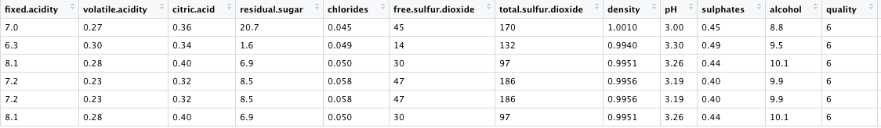
Sample of Data

Slide 5
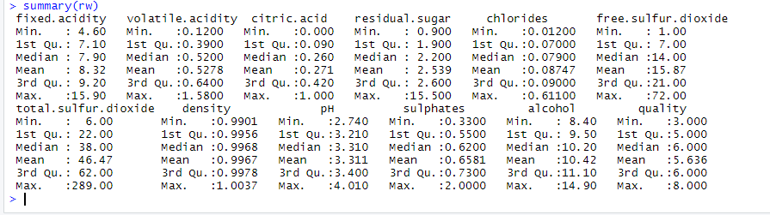
Basic Summary of Red Wine Data

Slide 6
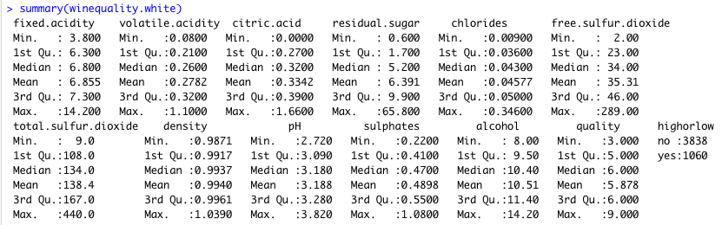
Basic Summary of White Wine Data

Slide 7
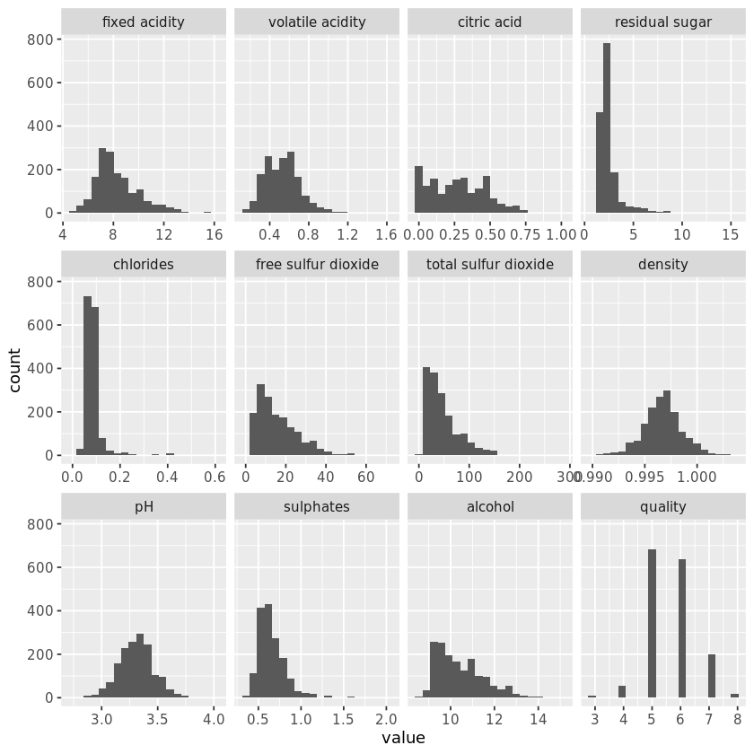
Histogram Red Wine
Notes:
· A majority of the attributes displayed similar distributions between Red and White
· The quality distribution between red and white were very similar as well with small counts for very high and very low quality and a majority of the wines being rated a 5 or 6.
· Another distinct similarity in many of the attributes was skewness to the right.
· PH was one attribute that had normal-like distributions in both red and white
· An attribute that was very different between red and white was density.
o In Red it resembled a normal distibution, while white did not.

Slide 8
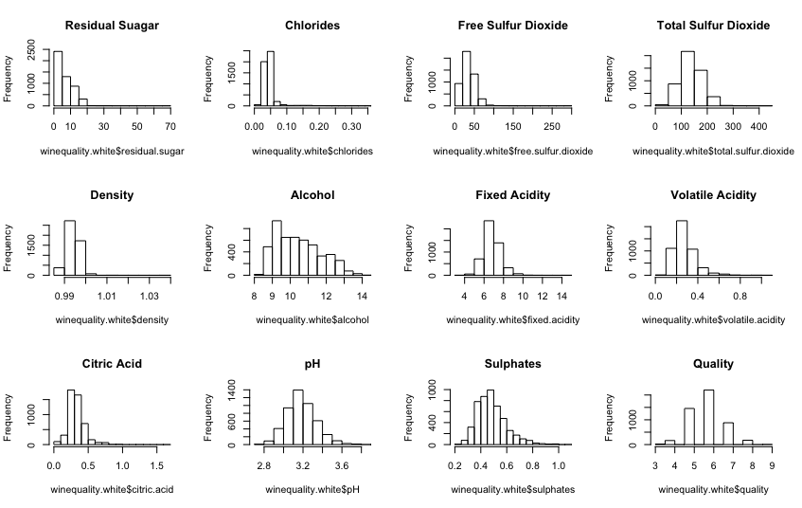
Histogram White Wine

Slide 9
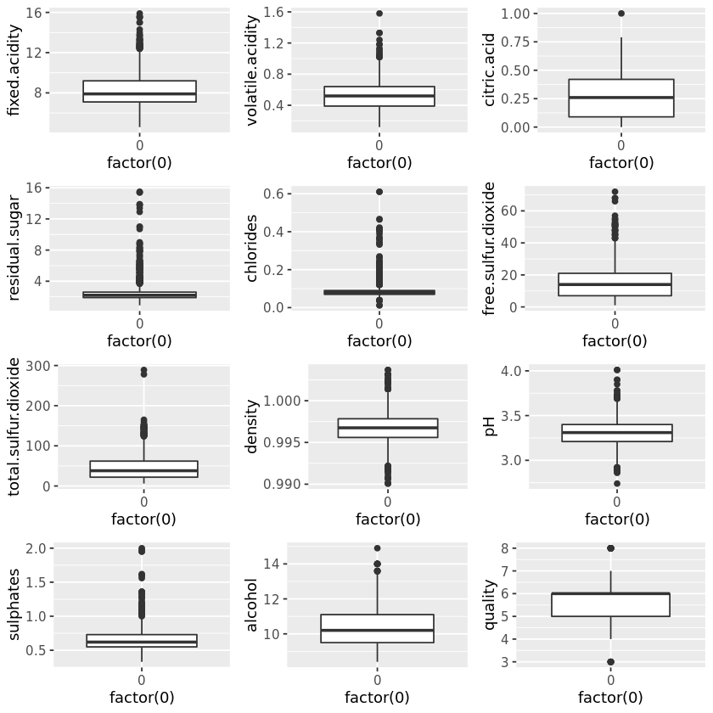
Box Plot of the Red Wine Data
Notes:
Red Wine
· alcohol and citric acid had well dispersed distributions, while residual sugar and chlorides were very condensed.

Slide 10
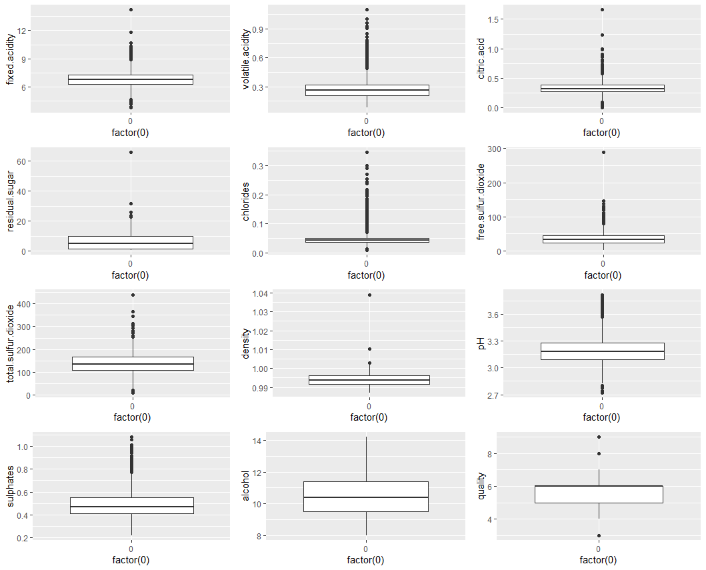
Box Plot of the White Wine Data
Notes:
White Wine
similar to the red wine, alcohol had a well dispersed distribution for white wine and chlorides were also condensed.
You can also see the right skewness from these plots for many of the attributes

Slide 11
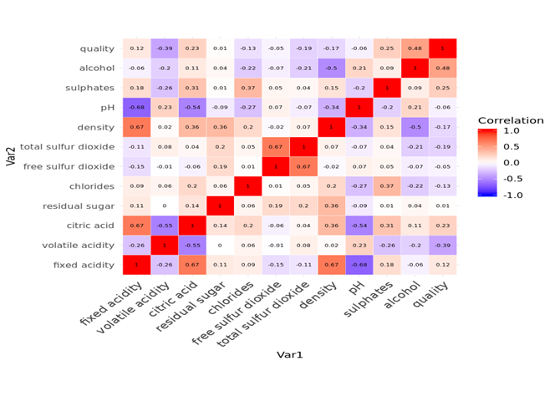
Correlations (Red Wine)
Notes:
Red Wine:
Density and fixed acidity had a strong positive correlation (surprising)
fixed acidity and PH had a strong negative correlation.

Slide 12
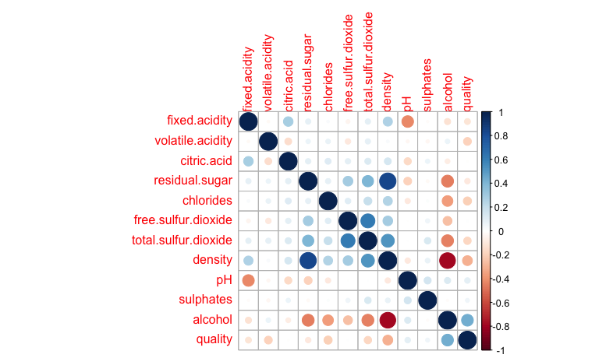
Correlations (White Wine)
Notes:
White Wine
o Residual Sugar and Density showed a positive correlation.
o alcohol and density showed a negative correlation.
this was one correlation we noticed was substantial in red as well.

Slide 13
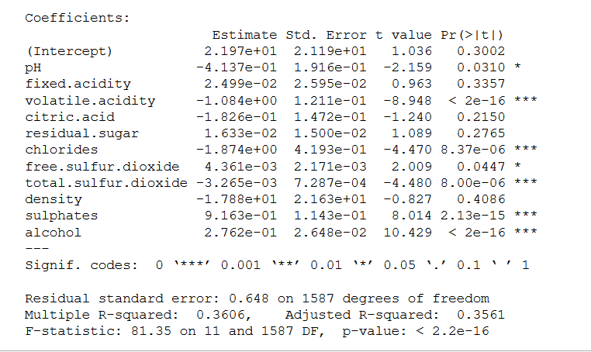
Linear Modeling for Red Wine
Notes:
P-value > 0.05
fixed acidity
citric acid
residual sugar
density
R-squared = .35 or 35%

Slide 14
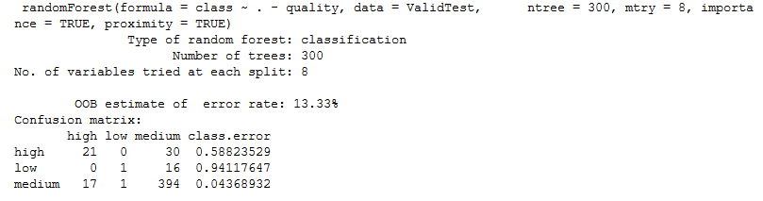
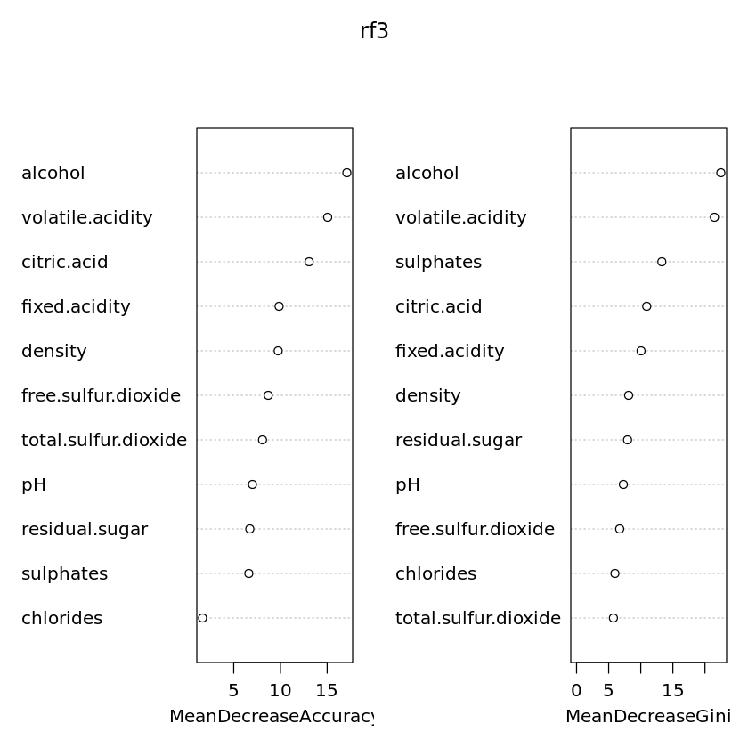


Random
Forest
for Red
Wine
Notes:
random Forest 87% accuracy predicting wine quality(wine quality data set)
random Forest 86.67% predicting wine quality (test data)

Slide 15
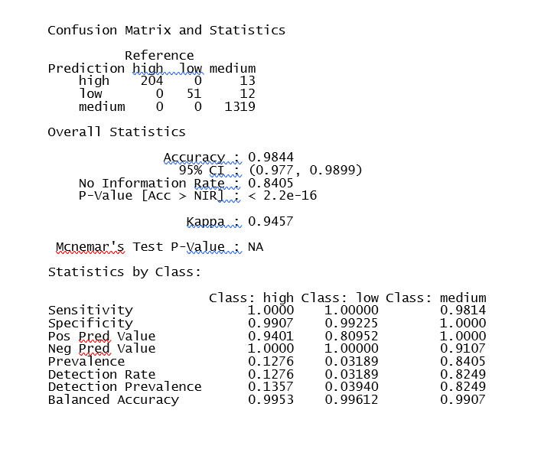
SVM
for Red
Wine
Notes:
Accuracy = 98%
sensitivity medium =98%
13 of the high predicted as medium
12 of the low is predicted as medium

Slide 16
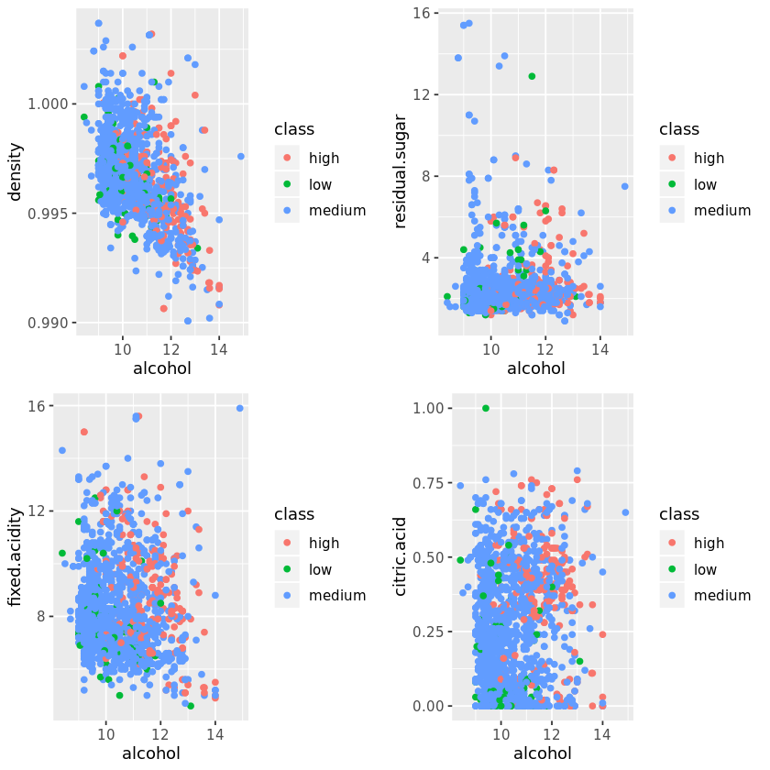
Red Wine

Slide 17
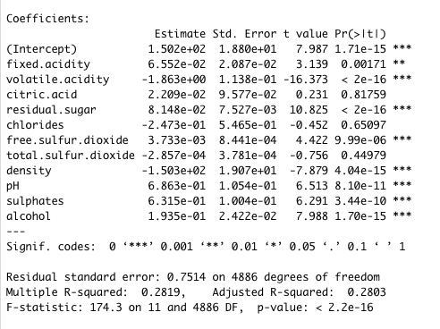
Linear Modeling for White Wine
Notes:
P-value > 0.05
Citric.acid
Chloride
Total.sulfur.dioxide

Slide 18
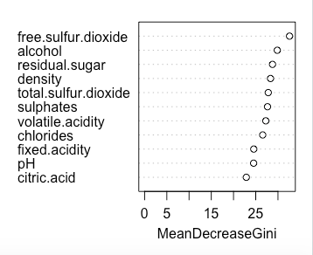
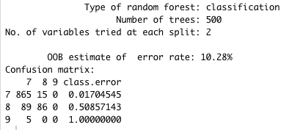
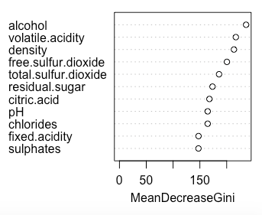
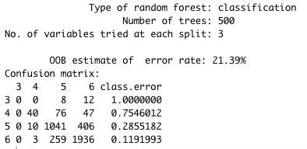
Random
Forest
for
White
Wine
High Quality
Low Quality

Slide 19
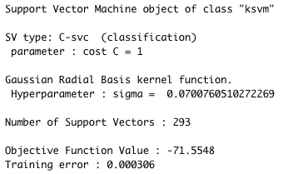

KSVM
for
White
Wine

Slide 20
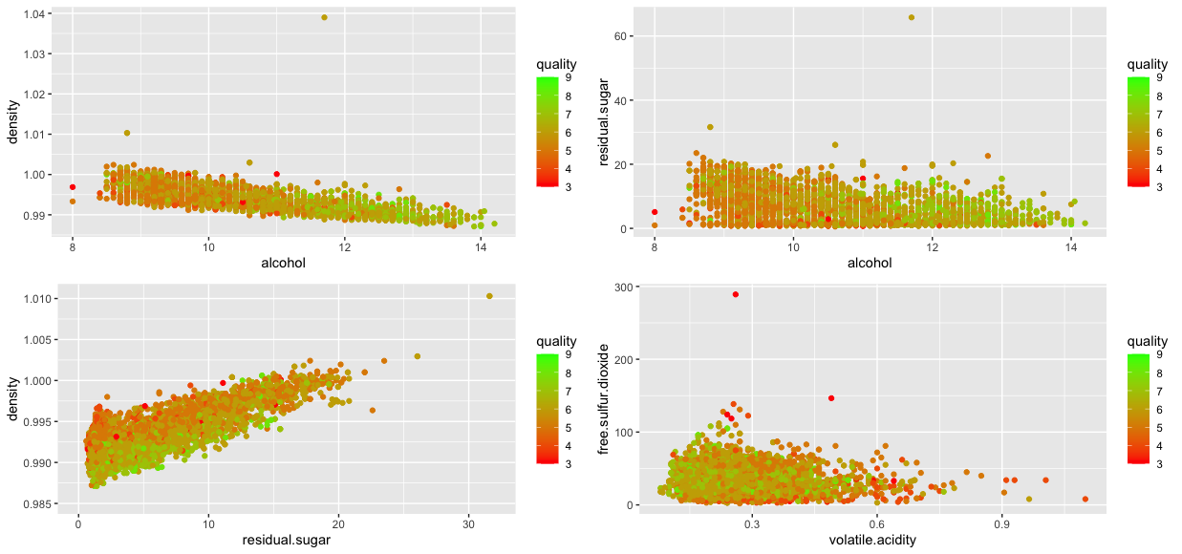
White Wine

Slide 21
Limitations
There are other variables that go into wine quality that we did not have data for such as grape type, barrel type, length of fermentation, other measures and chemicals, etc. .
Wine quality is also subjective as some people prefer a dry wine while others may judge a wine based on sweetness.
The quality data points are based on the median of at least 3 wine experts which could result in some skewed data and could explain why the majority of the wine is rated as a 5 or 6

Slide 22
Conclusion
Alcohol, density, volatile acidity, residual sugar, citric acid (for reds) and free sulfur dioxide are the variables that went into determining the wine quality
We were able to predict with 99.9% accuracy whether a wine was going to be high or low quality
With the challenges of not having more data and due to the quality rating being subjective it was difficult to predict the exact quality of the wine
With more data and more digging, we may be able to get more exact predictions
We believe that this a good start to show that there are some relationships between the makeup of the wine and the quality ratings that they receive, while realizing there will always be some aspect of bias involved.

